Slide 1
Movie DATA Analytics
An EDA Project
By: Vikas Rohra

Slide 2
Agenda
Data background.
Result of data analysis.
Conclusion.

Slide 3
Data background

Slide 4
WHat data is all about
A film, also called a movie, motion picture, moving picture, or photoplay, is a series of still images that, when shown on a screen, create the illusion of moving images.
An important art form, a source of popular entertainment, and a powerful medium for educating or indoctrinating citizens.
The visual basis of movie gives it a universal power of communication.

Slide 5
Data Description
The dataset consists of the information about various movies from the year 2006 to 2016. Various variables present in the dataset includes data of Title, Genre, Director, Rating etc.
The dataset comprises of 1000 observations of 12 columns.

Slide 6
Movie Data Fields
Column Name | Description
Rank | Movie rank
Title | The title of the movie
Genre | A comma-separated list of genres used to classify the film
Description | Movie summary
Director | The name of the film's director
Actors | A comma-separated list of the main stars in the movie.
Year | The year that the film released.
Runtime (Minutes) | The duration of the film in minutes.
Rating | User rating for the movie 0-10
Votes | Number of votes
Revenue (Millions) | Movie revenue in millions
Metascore | An aggregated average of critic scores. Values are between 0 and 100. Higher scores represent positive reviews.

Slide 7
RESult of data analysis

Slide 8
Question Addressed in Analysis
How many movies are produced year by year?
How critics ratings vary year by year?
Who are the top 10 actors by the numbers of movies done by them?
What are the top 10 runtimes of movies ?
Top Directors w.r.t Revenue
Why top director earned more ?
Top Directors w.r.t Rating
Why top director got high Rating ?

Slide 9
Question Addressed in Analysis
Max. movies got which Rating ?
Distribution of Ratings
Genre Trend in Part1 of Rating
Genre Trend in Part2 of Rating
Genre Trend in Part3 of Rating
Analysing Metascore and Rating
Analysing Rating and Votes.
Analysing Votes and Revenue

Slide 10
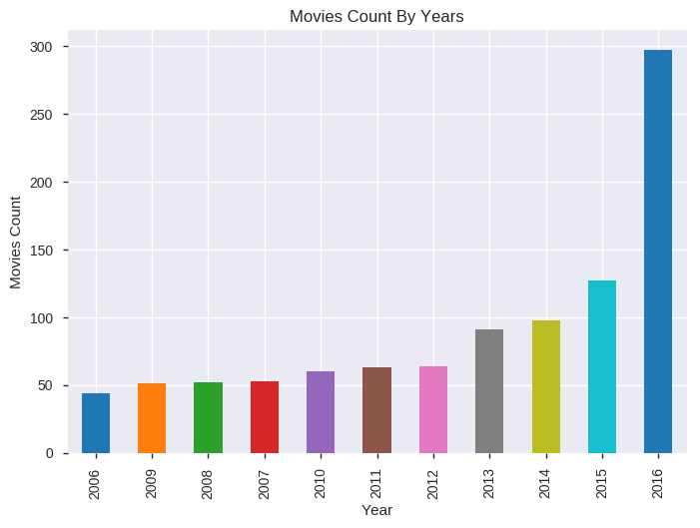
How many movies are produced year by year ?
"Movie count by Year" graph shows a consistent rise in Movies Count w.r.t year

Slide 11
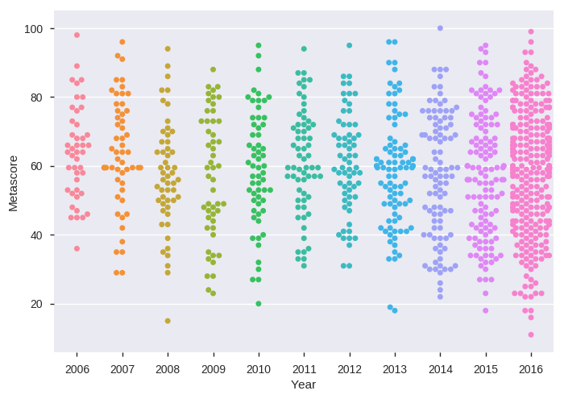
How critics ratings vary year by year ?
From the graph we can see most movies have metascore between 30 to 90 from year 2006 to 2016.
We can view that only 3 movies have just approached the metascore of 100 from year 2006 to 2016.

Slide 12
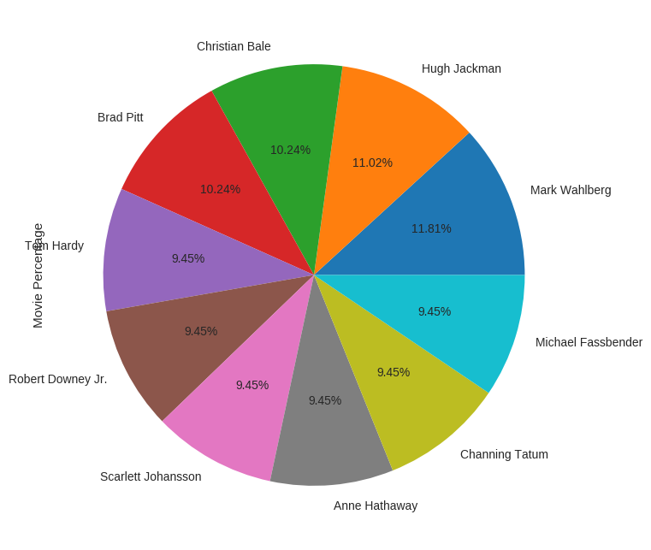
Who are the top 10 actors by the numbers of movies done by them ?
"Movie Percentage" pie chart shows that Huge Jackman and Mark Wahlberg have given more movies than others

Slide 13
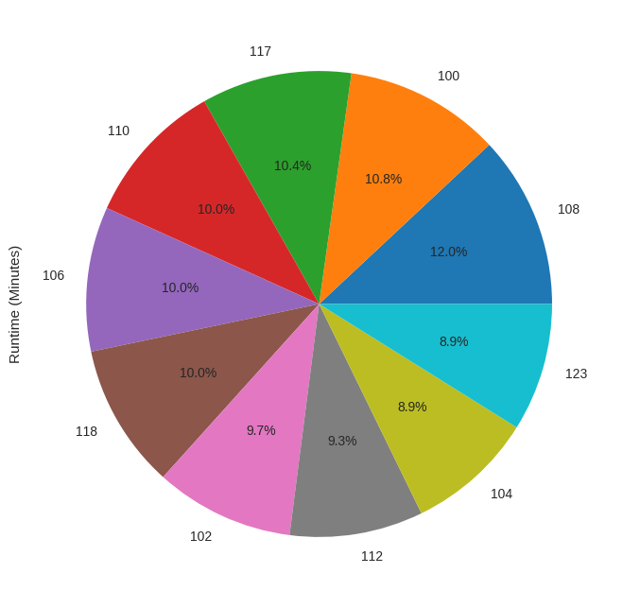
what are the top 10 runtimes of movies ?
We can infer that most of the movies Runtime(Minutes) tends to be less than or equal to 110.

Slide 14
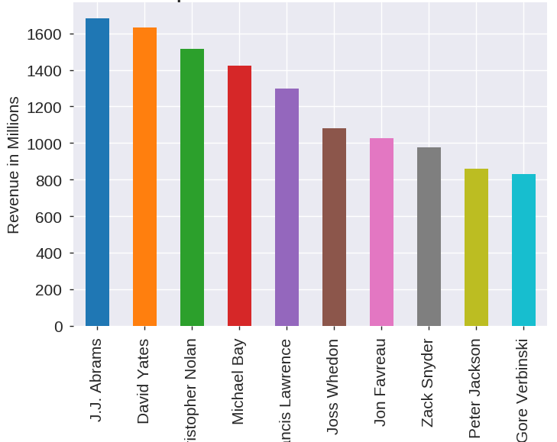
Top Directors w.r.t Revenue
"Top Directors w.r.t Revenues" graph shows that "J.J. Abrams" is the most successful director w.r.t Revenues

Slide 15
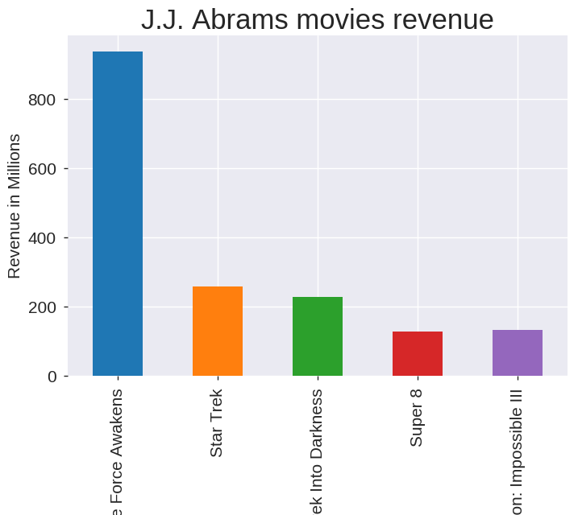
Why top director earned more ?
We can see from above graph that, J.J. Abrams revenue is at the top due to "Star Wars : Episode VII - The Force Awakens" movie which contributed almost 55% of his revenue (to be specific 936.63 millions) and this is the highest earning movie

Slide 16
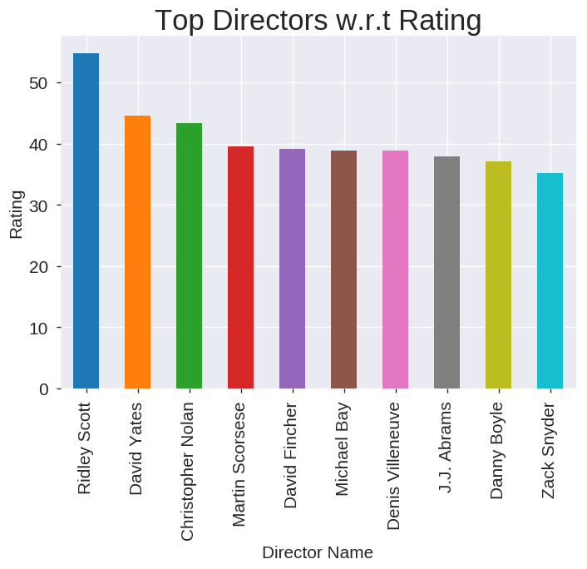
Top Director w.r.t Rating
"Top Directors w.r.t Rating" graph shows that "Ridley Scott" is the most successful director w.r.t Rating.

Slide 17
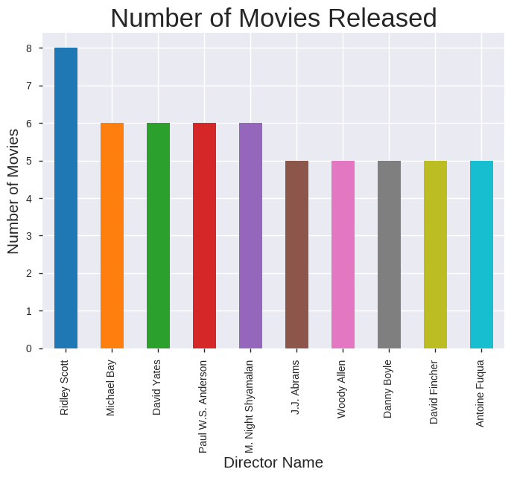
Why top director got high rating ?
Why Riddley Scott got max. rating?
Maximum movies are released by "Ridley Scott"

Slide 18
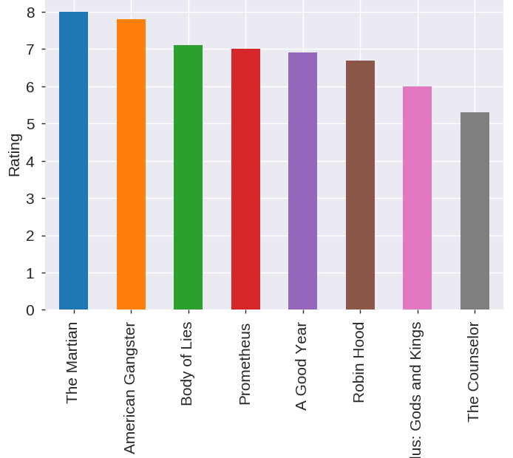
Why top director got high rating ?
Why Riddley Scott got max. rating?
People likely to give good rating to the "Ridley Scott" movie as we can see that almost all his movies got 6 or more than 6 rating except one movie.

Slide 19
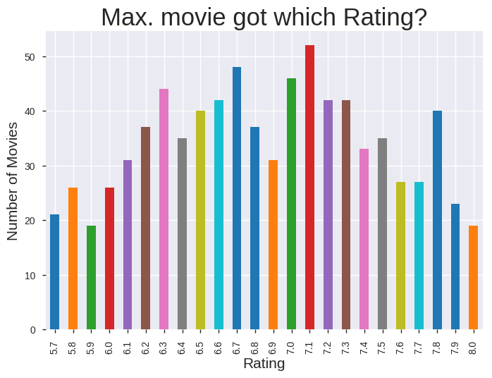
Maximum movies got which Rating ?
The graph shows that Max. numbers of movies got 7.1 ratings.

Slide 20
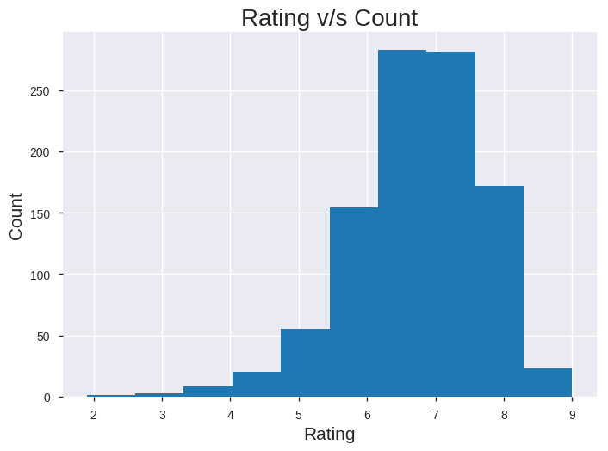
Distribution of ratings
We can see from histogram that:
Part 1 : 6.1 to 7.5 rating (This is where most of the Rating lie)
Part 2 : Less than 6.1
Part 3 : Greater than 7.5

Slide 21
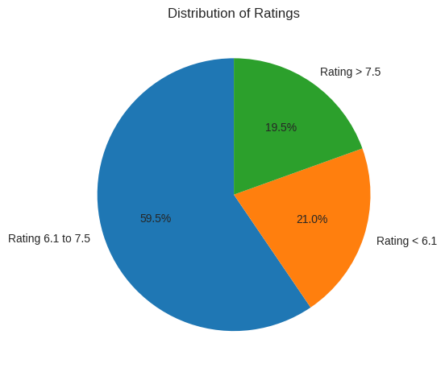
Distribution of Ratings
We can see that:
Part1 (6.1 to 7.5) : Contributes 59.5% of the movies data
Part2 (Less than 6.1) : Contributes 21% of the movies data
Part3 (Greater than 7.5): Contributes 19.5% of the movies data

Slide 22
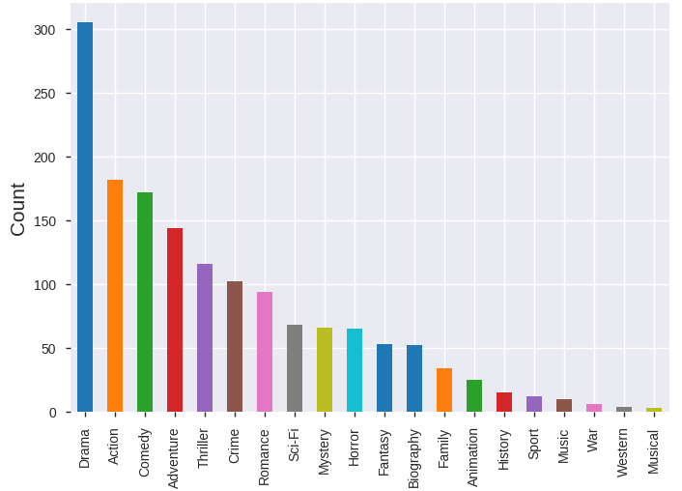
Genre Trend in Part1 of Rating (i.e. movies which got Rating from 6.1 to 7.5)
We can see from the graph that in Part1 "Drama" is the most dominating Genre

Slide 23
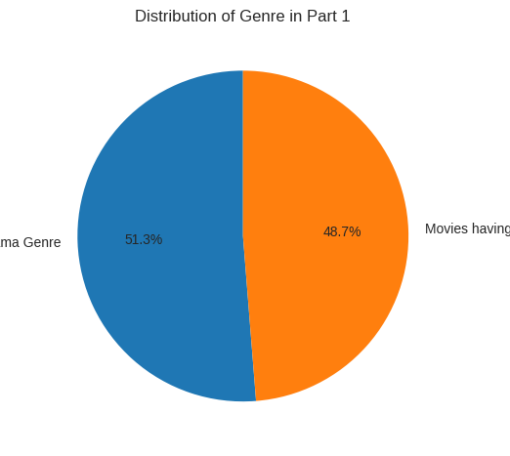
Genre Trend in Part1 of Rating (i.e. movies which got Rating from 6.1 to 7.5)
We can say 51.3% of the part1 movies having "Drama" Genre

Slide 24
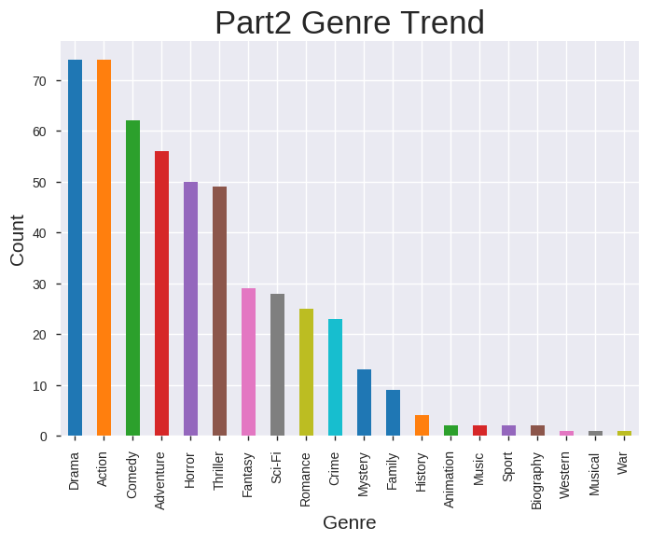
Genre Trend in Part2 of Rating (i.e. movies which got Rating less than 6.1)
We can see from above graph that in Part2 "Drama" and "Action" both are dominating w.r.t other Genere

Slide 25
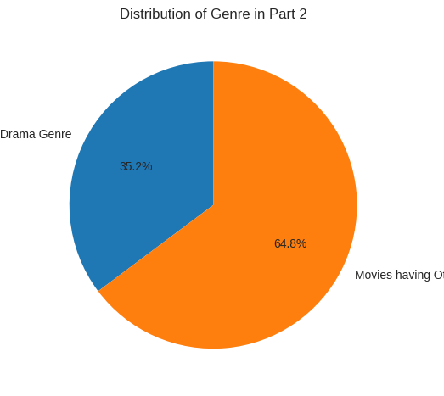
Genre Trend in Part2 of Rating (i.e. movies which got Rating less than 6.1)
We can say 35.2% of the part2 movies having "Drama" Genre

Slide 26
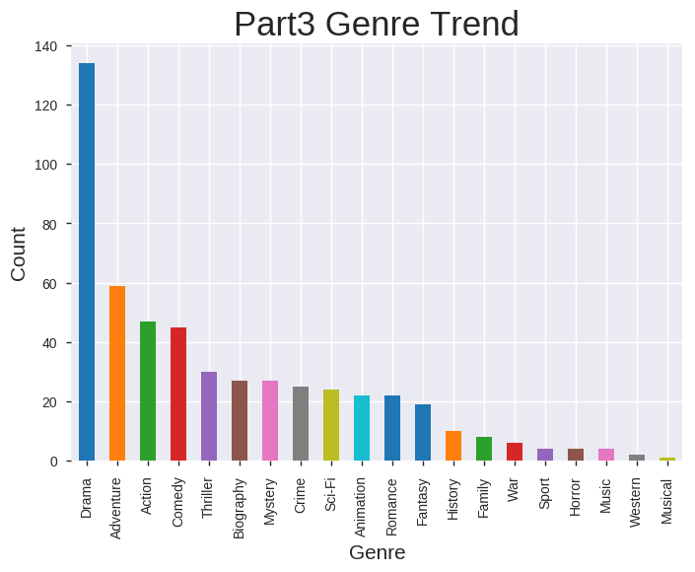
Genre Trend in Part3 of Rating (i.e. movies which got Rating greater than 7.5)
We can see from the graph that in Part3 "Drama" is most dominating w.r.t other Genere:

Slide 27
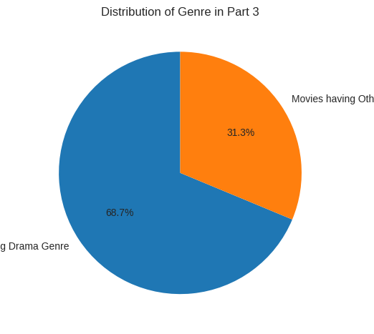
Genre Trend in Part3 of Rating (i.e. movies which got Rating greater than 7.5)
We can say 68.7% of the part3 movies having "Drama" Genre

Slide 28
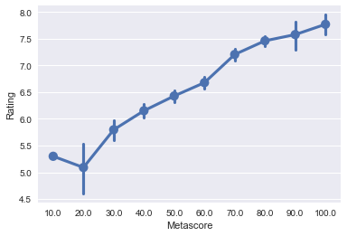
Analyzing rating and metascore
Metascore v/s Rating graph shows that as Metascore increases Rating also increases.

Slide 29
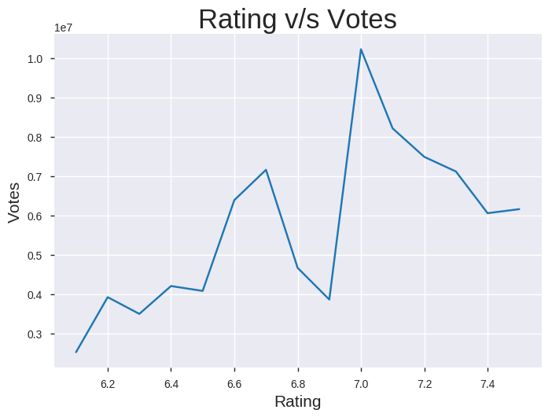
Analyzing Rating and votes
Rating v/s Votes graph shows that as Rating increases Votes also increases.

Slide 30
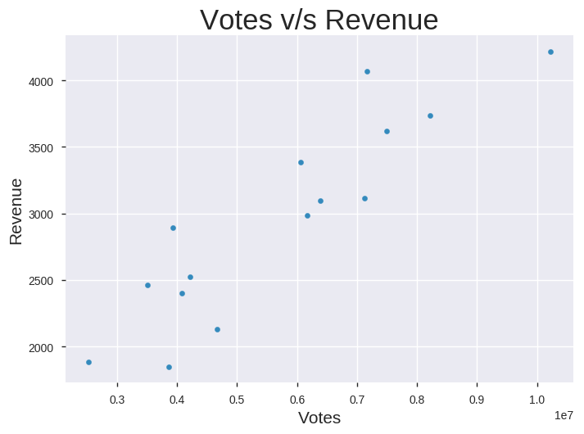
Analyzing votes and Revenue
Votes v/s Revenue graph shows that as Votes increases Revenue also increases

Slide 31
Conclusion

Slide 32
From the above analysis, we can conclude that success of the movies (i.e. Revenue) depends upon Metascore,Rating and Votes. As Metascore increases Rating increases,as Rating increases Votes increases and as Votes increases Revenue increases.
We can infer that movies of Drama genre is mostly liked by people.
Movies which got rating, less than or equal to 6 need to be more focus on having Drama genre. Data says that only 35.2% of the movies in part2 contains Drama genre.
In order to generate good revenue, director need to analyse the "Star Wars : Episode VII - The Force Awakens" movie and create a movie like "Star Wars : Episode VII" as this movie generates maximum revenue.

Slide 33
Thank you

